Slide 1


.
MY PHILANTHROPY

Slide 2

CONTENT
01
THE PROBLEM
02
Solutions
03
IMPLEMENTATION
04
FEATURES

Slide 3
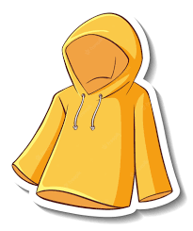
THE PROBLEM
In our world, a significant number of individuals lack access to basic necessities like clothes and other belongings. Simultaneously, many people possess an excess of unused items that are still in good condition. However, the existing process of donating these items often presents challenges and discourages individuals from taking action. As a result, perfectly usable belongings end up being discarded instead of reaching those in need
The problem lies in the lack of an efficient and accessible solution for connecting donors with NGOs and facilitating seamless donations. The current process requires individuals to navigate through various obstacles, such as identifying people in need and coordinating the logistics of donation. This additional layer of effort acts as a deterrent, leading to missed opportunities to help and wasted resources.

Slide 4
OUR SOLUTION
Our groundbreaking solution revolutionizes the way donations are made by providing a seamless and impactful platform that connects donors with NGOs effortlessly.
We have engineered an innovative approach that eradicates the barriers and frustrations often associated with the donation process.
Our user-friendly platform empowers individuals to list their unused belongings and connect with nearby NGOs instantly, without the need for time-consuming searches or logistical hurdles.
By simplifying the donation journey, we inspire a wave of generosity and make it effortless for individuals to make a tangible difference in the lives of those in need.
Through our transformative solution, we are reshaping the landscape of giving, fostering a culture of compassion, and ensuring that every donation finds its deserving home.
Join us in creating a ripple of positive change as we unlock the true potential of generosity and pave the way for a brighter and more inclusive future

Slide 5
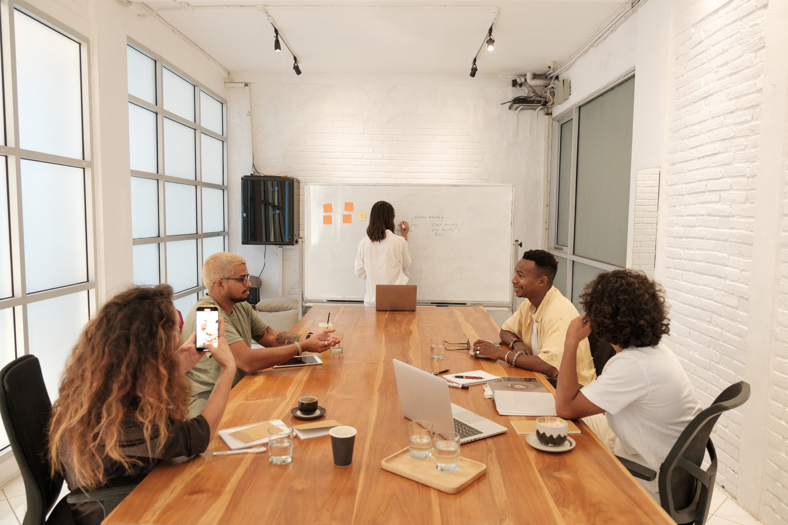



ABOUT US
At My Philanthropy, connect with trusted NGOs for impactful donations. Browse profiles, choose a cause, and contribute effortlessly. Create a listing, provide details and photos, and coordinate seamlessly. Join us, inspire others, and transform belongings into meaningful contributions.
At My Philanthropy, we simplify and amplify giving. Connect with trusted NGOs, donate belongings effortlessly. Join our community, create lasting impact through the power of giving. Together, let kindness find purpose at My Philanthropy.

Slide 6

PROJECT FEATURES

Slide 7




TECHNOLOGIES USED
LOCATION : Google Maps API
APRAISAL BADGES :
To make people feel proud and encourage them
ACCESSIBILITY:
Visibility of all nearby NGOs AND Help Centres
DONATION IMPACT STORIES:
Share success stories and impact reports highlighting how donations have made a difference in the lives of individuals and communities.

Slide 8





GOALS AND OBJECTIVES
Objective n° 1
Objective n° 2
Objective n° 3
Provide an easy way to
share give back to society.
Weed away the reluctance in people’s minds due to improper channeling and efforts.
Help the needy people.

